Slide 1

- Abdul Saboor Hamedi
- M.A Thesis Defense
- UIII - Universitas Islam Internasional Indonesia

Slide 2
Women's Education in Afghanistan: Activists, the Taliban, and Public Views

Slide 3
Outlines
01
Introduction
Literature Review
Hypothesis
Argument
02
Method
Data Collection Data Cleaning
Labeling Data
03
04
Find
Conclusion

Slide 4
Introduction
Main Focus
This study investigate women's education from three different views, namely: Activists, the Taliban and public views
Benefit
Research indicates that women who receive education are more likely to have expanded opportunities, particularly in non-farm sectors (Anderson et al., 2021).
Barriers
Women in patriarchal and conservative countries like Afghanistan face significant barriers to education, limiting their daily lives and access to public activities.

Slide 5
Research Problem
Research Question
Research Objective
Significant of study
What are the views of activists, Taliban, and the public regarding women's education in Afghanistan, and how does gender influence activists' views on the topic?
Uncovering gender dynamics: Examining tweets to understand cultural elements affecting women's education.
Amplifying marginalized voices: Giving voice to underrepresented communities through social media analysis.
Advancing gender equality: Using Twitter to identify barriers and promote inclusive education environments.
Views of activists, the Taliban, and the public sheds light on barriers to education for Afghan women.
This study investigates women's education in Afghanistan through the views of activists, the Taliban, and the public, considering the influence of gender norms and the varying viewpoints of different groups.

Slide 6
Literature Review
Education serves as a powerful tool in enhancing women’s socio-economic prospects and promoting gender equality. Activists, particularly those with educational backgrounds, play a vital role in advocating for women’s education and challenging social inequities (Anderson et al., 2021; Lyytikäinen, 2013).
Historical examples, such as African American women teachers in Harlem during the 1930s-1950s and activists at Lakshmi Ashram, demonstrate the transformative impact of education on empowering women and challenging gender norms (Johnson, 2004; Klenk, 2010). However, the Taliban's opposition to women's education in Afghanistan has resulted in limited opportunities and rights for women, raising concerns about the current state of women’s education in the country (Karlsson & Mansory, 2008; Inayatullah, 2022).
Despite these challenges, activists continue their efforts to advocate for women’s education, aiming for equality and community empowerment (Ren, 2010). Overall, education and activism play a crucial role in driving social change, challenging power structures, and promoting gender equality.

Slide 7
Weakness
One weakness observed in the existing literature is that most respected scholars have focused their research on a small number of villages, which limits the scope of their findings. Their data mainly comes from a specific group within these villages, potentially leading to biased results that may not apply to a wider population. In contrast, our study aims to address this limitation by including a diverse range of participants, such as Activists, the Taliban, and Public. This broader approach allows us to gather insights from different views and better grasp the intricate dynamics of women’s education in Afghanistan. By doing so, our research seeks to fill the gap in existing literature and provide a more comprehensive understanding of the topic.

Slide 8
Argument
I argue, the Taliban restricts women’s education, insisting patriarchal structure. Activists oppose it. Activists champion empowerment and social change through education, but female activists are stronger in their support for women’s education than male activists. The public holds diverse views influenced by education, religion, and cultural background.

Slide 9
Hypothesis
The Taliban's views regarding women's education will be significantly more restrictive and opposed than those of activists and public.
Activists are more likely to demonstrate higher support for women's education compared to both the Taliban and Public.
Female activists are more likely to hold higher sentiments for supporting women's education compared to male activists.

Slide 10
Method
The study employed content analysis (Evans & Clark, 2015) and sentiment analysis to test the hypothesis.
Content analysis
Content analysis is a research method that examines texts to identify patterns and themes. It involves analyzing written documents, transcripts, or social media posts to gain insights.
Sentiment analysis is a method that analyzes text to determine the emotional tone expressed, such as positive, negative, or neutral, in sources like social media posts, customer reviews, and survey responses.
Sentiment Analysis

Slide 11
Analysis
Data Collection: Start from December 01, 2022 to March, 30, 2023.
Activists: Online Google, Twitter Spaces, and TV shows.
Taliban: Zabihullah, and Mobeen Khan.
Public: Tolo News, and Ariana News, from comments.

Slide 12
Data Cleaning
Remove URL
Remove Hashtags
Remove noises
Remove duplicates
Remove missing values
Labeling Data
Label The Data based on five keywords
Women, education, schools, university, and girl, (1-0)
Unclean | Clean
RT @Malala: While banning girls from school, the Taliban are also arresting champions of education. @matiullahwesa founded @penpath1 to pro… | malala banning girl school taliban also arresting champions education matiullahwesa founded penpath pro
Since 555 days, #Afghan #girls #education centers closed in #Afghanistan. Quality Education has the power to transform societies in a single generation. Afghan girls &amp; women need quality education. They need support &amp; help For Formal education, #LetAfghanGirlsLearn https://t.co/2hdSbFAIaC | since days afghan girl education centers closed afghanistan quality education power transform societies single generation afghan girl women need quality education need support help formal education let afghan girl learn
@matiullahwesa is the voice of Afghan generation. He is peaceful education activist. He want to Education for all in Afghanistan. We are all also have obligation to rise voice for Afghan girls and women education in Afghanistan. #RelaeseMatiullahwesa #LetAfghanGirlsLearn https://t.co/Yv4BBSNrB4 | matiullahwesa voice afghan generation peaceful education activist want education afghanistan also obligation rise voice afghan girl women education afghanistan relaesematiullahwesa let afghan girl learn
Negotiating the ban on women education in Afghanistan is so silly. Explaining to anyone why Afghan women have the right to get an education is so silly. Explaining how and why Islam supports is so silly. It is all just waisting time. #Taliban wont allow so the wait is also silly. https://t.co/sk5VtLjAiD | negotiating ban women education afghanistan silly explaining anyone afghan women right get education silly explaining islam supports silly waisting time taliban wont allow wait also silly
The war in Afghanistan is to destroy the idea of ​​education. This war started fifty years ago. The world cannot even imagine how many teachers, students and education workers have been killed and how many schools have been burned in Afghanistan. https://t.co/IkUwrNtI3Z | war afghanistan destroy idea education war started fifty years ago world cannot even imagine many teachers students education workers killed many school burned afghanistan

Slide 13
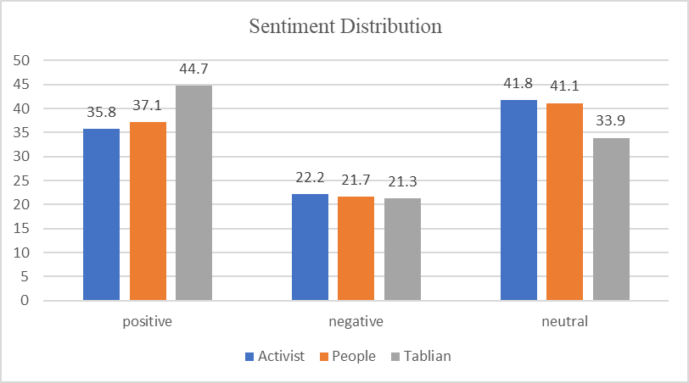
Findings: Activists, Taliban and Public Views
Taliban has higher positive
People also, higher
Activists
Their data also, larger

Slide 14
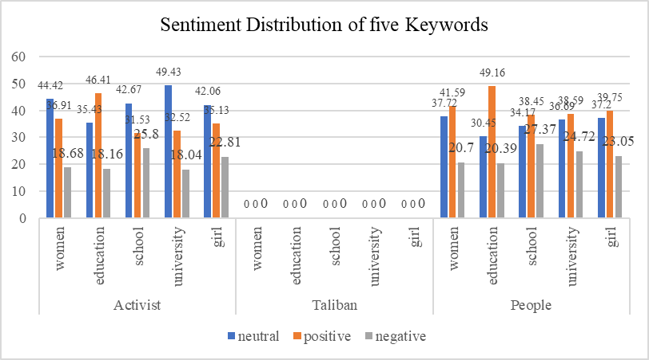
Descriptive Tweets and Sentiment Distribution of Five Keywords
We cannot calculate of five keywords for the Taliban, because its too small compared to activists and the public. And the table shows the Taliban tweets related to five keywords
Tweets Related to Keywords
jobs allocated women educational sector today announced ministry education jobs teachers administrative staff male female states herat farah ghor badghis nangarhar laghman kunar nuristan
many years uzbekistan hijab allowed women educational institutions
public private universities throughout country open men women education process extended percent remaining parts country thousands women education higher education public health id passport offices airports police media

Slide 15
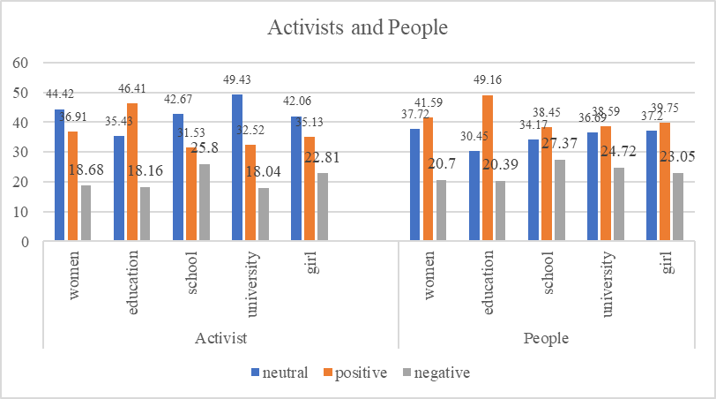
Activists and People
Activists, and People,
Compare activists tweets on five keywords
Activists has the higher rate of tweets related to women’s education

Slide 16
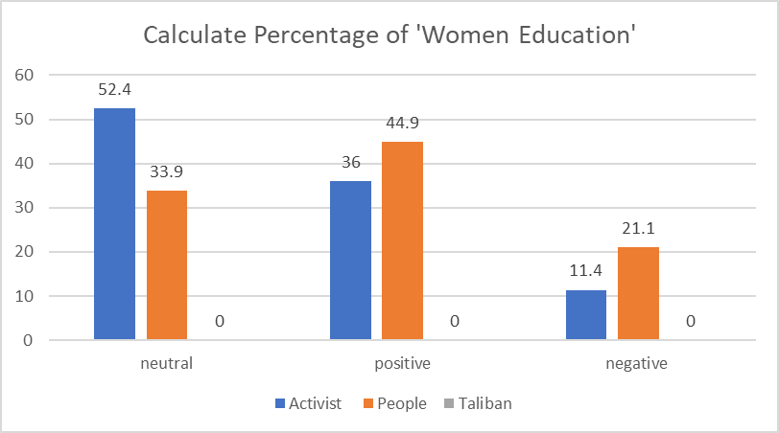
Calculating the Percentage of 'Women Education'
Cannot calculate Taliban's percentage,
People are more harsh using 'women education'.
Activists balance their words

Slide 17
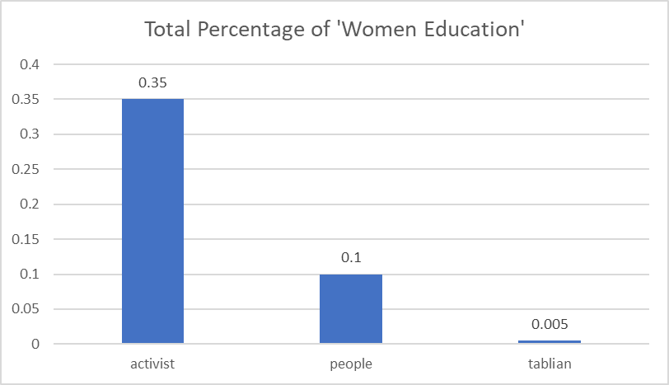
Total Percentage of 'Women Education'
Activists, mentioned, 183 (0.35%)
People mentioned, 109 (0.005%)
Taliban mentioned, 4, no percentage

Slide 18
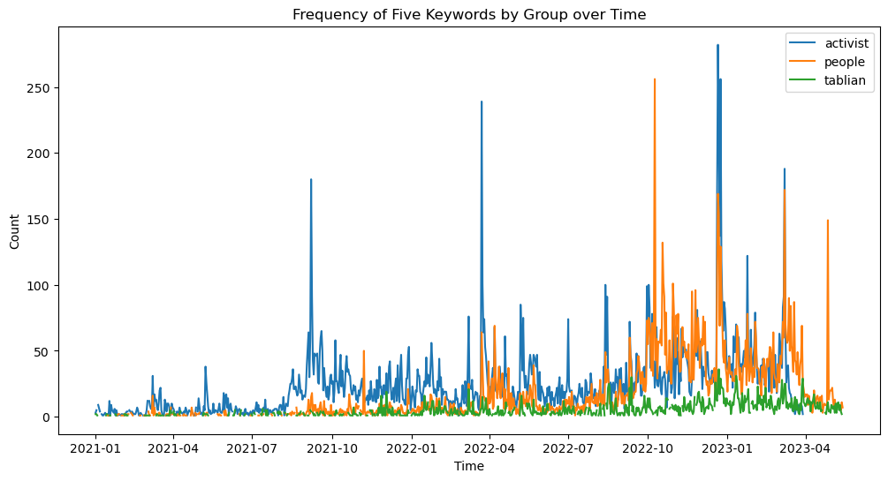
Analyzing Keywords Through Time
Activists frequently uses keywords
People have the same, but less than the activists
Taliban have the smallest use of keywords

Slide 19
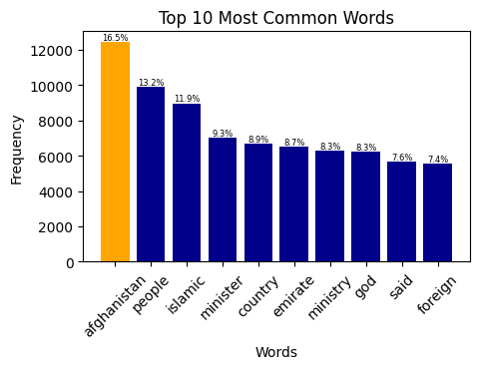
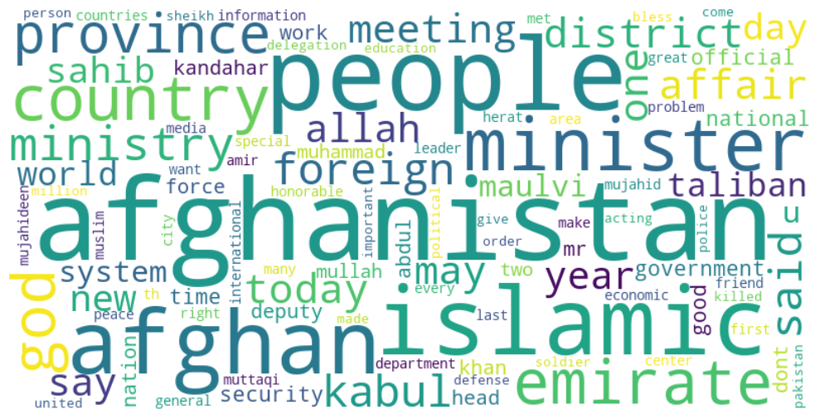
Top Frequent Words and Word-Cloud, Taliban
No tweets related to education
Main focus on Islamic aspect and Political aspect, such traveling and vesting other countries

Slide 20
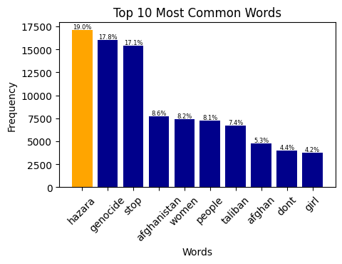
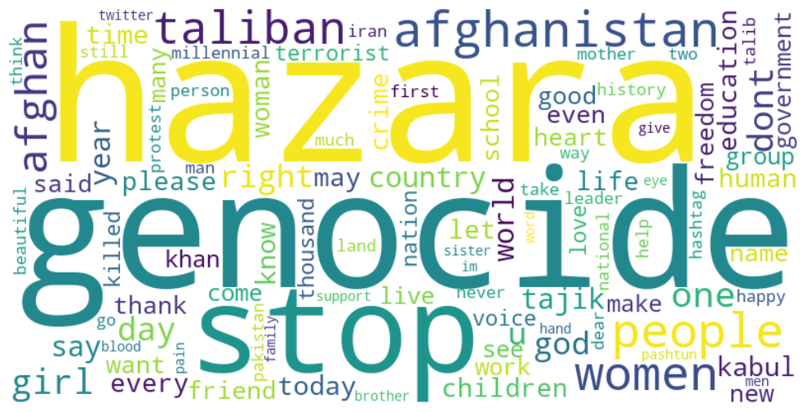
Top Frequent Words and Word-Cloud, Female
Public concern about genocides
Blaming Taliban for banning women’s education

Slide 21
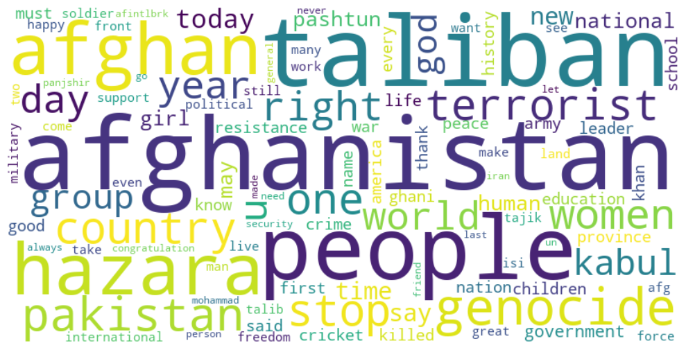
Top Frequent Words and Word-Cloud, Male
Male compared to female has lower tweets regarding genocides and women’s education.
Mostly says, Taliban come to power through the neighbor countries such as ‘Pakistan’

Slide 22
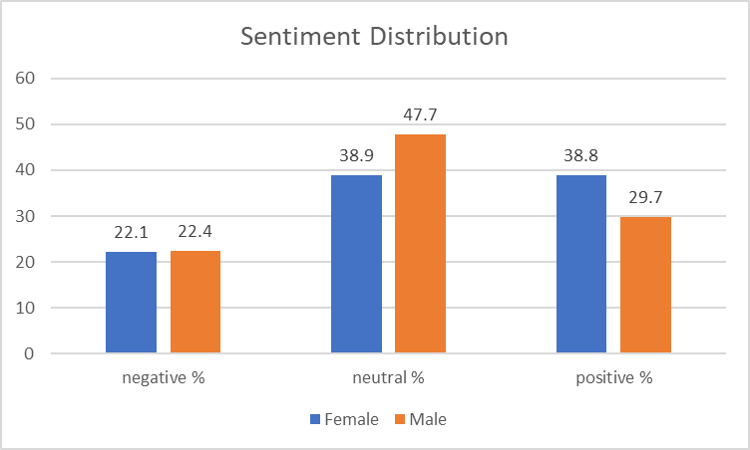
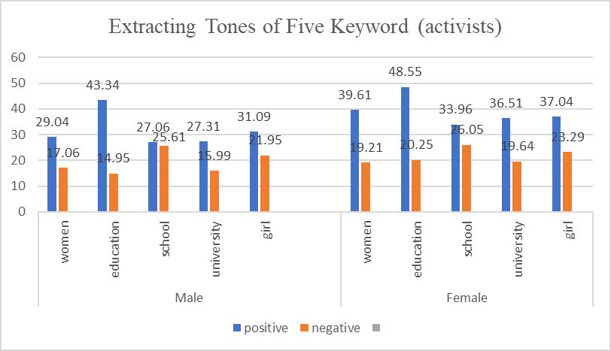
Findings: Male and Female Activists View
Implement Sentiment across the dataset
Provide insight
The tone of five keywords on activists
Sentiment Distribution (Activists)
Extracting Tones of Five Keyword (Activists)

Slide 23
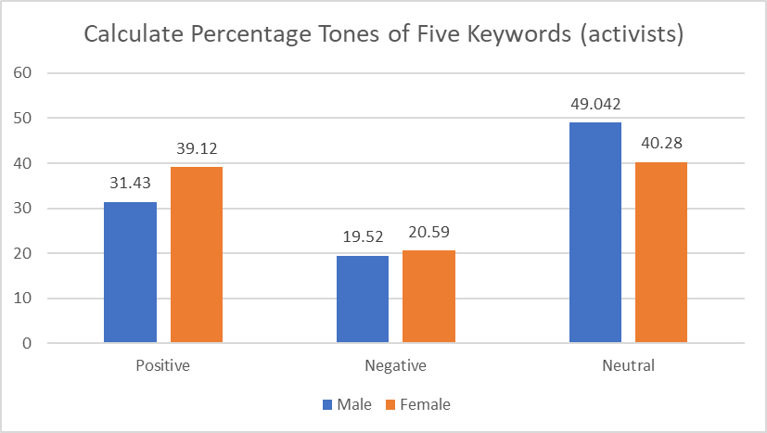
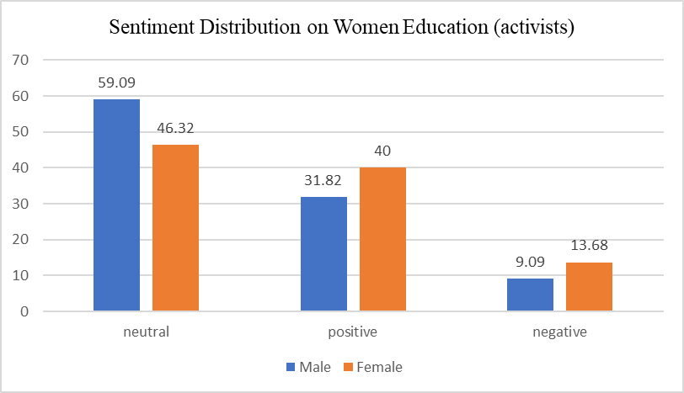
Five Keywords, and ‘Women Education'
Calculating Total Percentage of five keywords
Female has the highest percentage
Calculating the Total Percentage of 'women education' keyword,
Female activists has higher tone
Male are more neutral
Calculate Percentage Tones of Five Keywords (Activists)
Calculate Percentage Tones of Five Keywords (Activists)

Slide 24
Measure Five Keywords
For keywords: Women's tweets on education deviate significantly from neutrality (t-statistic: 28.32%, p-value: 1.69%).
Gender | T-Statistic | P-Value
Male | 12.23% | 4.97%
Female | 28.32% | 1.69%
Calculate Sentiment Scores for Five Keywords (Activists)

Slide 25
Measure ‘Women Education'
'Women Education': differ significantly in sentiment expression (males: t-statistic 2.59%, p-value 0.01%; females: t-statistic 3.43%, p-value 0.00%). This underscores the need to consider gender perspectives in discussions about women's education.
Gender | T-Statistic | P-Value
Male | 2.59% | 0.01%
Female | 3.43% | 0.00%
Calculate Sentiment Scores for Women Education (activists)

Slide 26
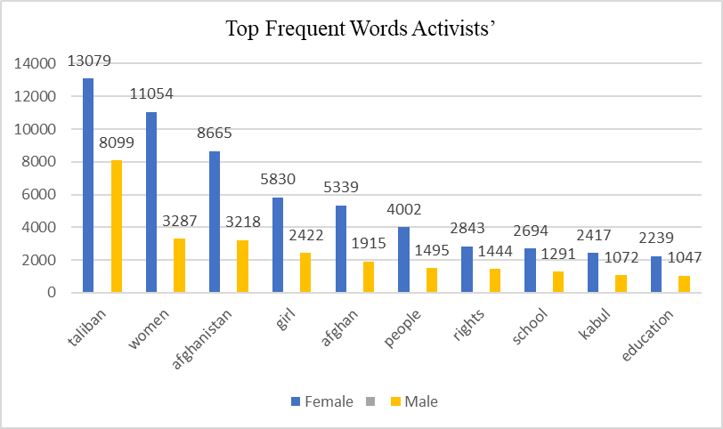
Top 10 Frequent Words
Top 10 frequent words, both male and female
Female, has the most mentioned words, ‘’education, ‘women’, ‘girl’, ‘right’, compared to male

Slide 27
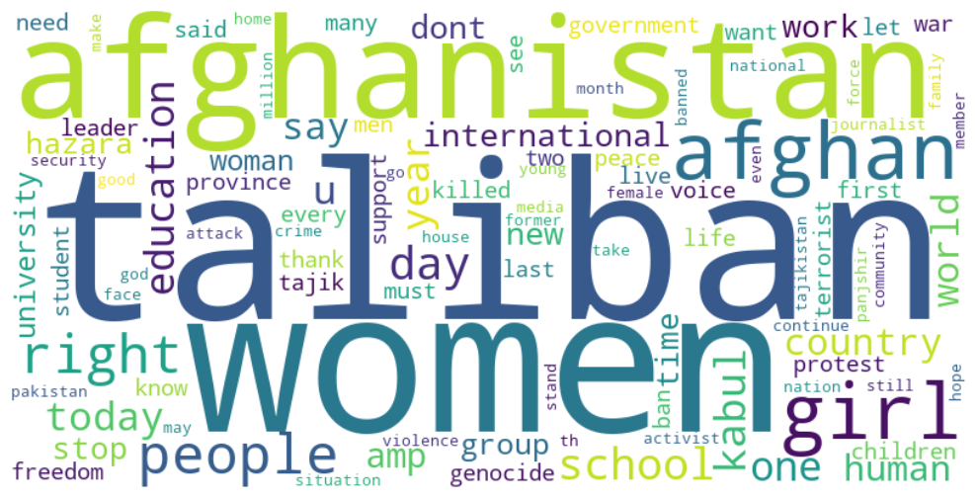
Female Word-Cloud
Females mostly tweet regarding women’s education
Women right, and equality
Female Activists Word-Cloud

Slide 28
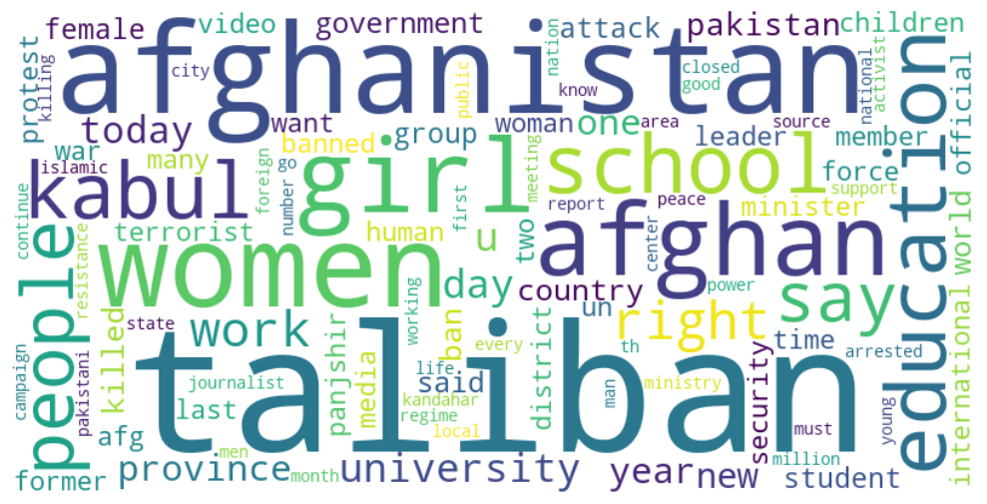
Male Word-Cloud
Male also does the same thing, but as lower tweets compared to female.
Male Activists Word-Cloud

Slide 29
Activists, Logistic Regression
Male 0
Female 1
This finding highlights the critical function of activists in promoting women's education
Optimization terminated successfully.
Current function value: 0.666068
Iterations 4
Logit Regression Results
==========================================================================================
Dep. Variable: label No. Observations: 52246
Model: Logit Df Residuals: 52244
Method: MLE Df Model: 1
Date: Thu, 01 Jun 2023 Pseudo R-squ.: 0.0002533
Time: 20:25:14 Log-Likelihood: -34799.
converged: True LL-Null: -34808.
Covariance Type: nonrobust LLR p-value: 2.681e-05
=============================================================================================
coef std err z P>|z| [0.025 0.975]
---------------------------------------------------------------------------------
const -0.5241 0.016 -33.420 0.000 -0.555 -0.493
Female 0.0803 0.019 4.194 0.000 0.043 0.118
=============================================================================================

Slide 30
Conclusion
Women’s education in Afghanistan highlights the divergent perspectives and motivations of different groups. Activists play a crucial role in advocating for education as a means of empowerment and social progress. They recognize the transformative power of education in challenging societal norms, breaking oppressive systems, and contributing to the overall development of communities. On the other hand, the Taliban holds a contrasting view rooted in religious fundamentalism and traditional gender roles. They perceive women's education as a threat to their established order and impose severe limitations on access, hindering progress towards gender equality.
The public's attitudes towards women’s education in Afghanistan are influenced by various factors such as education, religious beliefs, and cultural backgrounds. While some individuals align with the activist perspective and advocate for equal opportunities for women, others may hold reservations or oppose women’s education due to adherence to societal norms and traditional values. This diversity of perspectives adds complexity to the discourse surrounding women’s education in Afghanistan and underscores the need for nuanced approaches to promote education and engage with different segments of society. Understanding and addressing these varying viewpoints is essential in formulating effective strategies and policies that advance women’s education and work towards achieving gender equality in the country.

Slide 31
Thanks to
The Indonesian International Islamic University (IIIU) for providing me with a fully funded scholarship that has been instrumental in supporting my studies for the past two years. I am truly grateful for the sense of community that IIIU offers, as it has provided invaluable assistance in overcoming various challenges that I have encountered along the way.
Additionally, I would like to extend my heartfelt appreciation to my supervisors, Dr. Sirojuddin Arif, Ph.D., who has been an incredible mentor and has shown immense patience in guiding me through my academic journey, and to Dr. Nia Deliana, Ph.D., and Dr. Afrimadona, Ph.D., for their valuable insights and support. I am also indebted to every member of the Faculty of Social Sciences for their contributions to my education. Finally, I would like to sincerely apologize for any mistakes I may have made, whether intentional or unintentional, throughout my studies.

